Slide 1
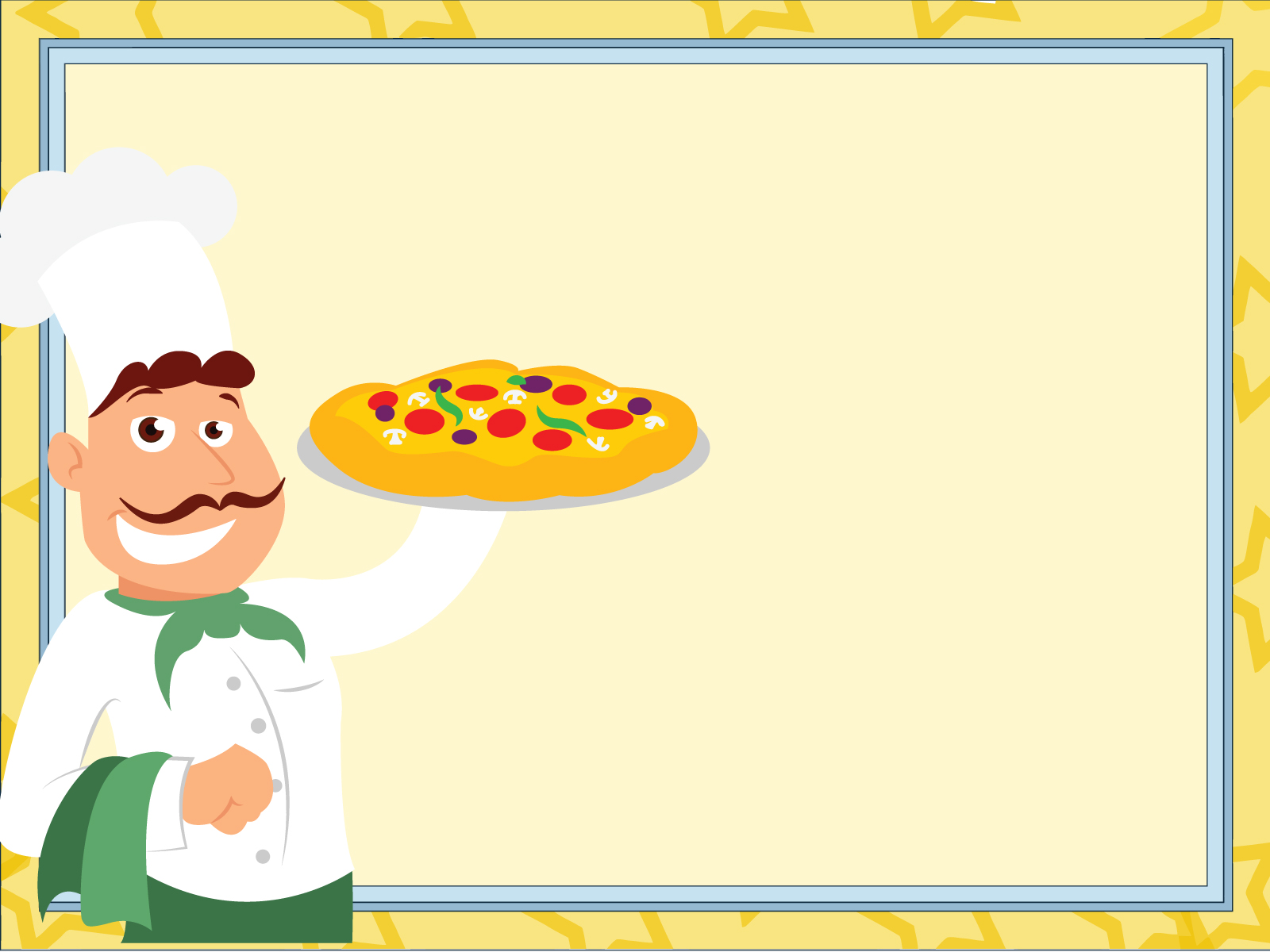
Problem Statement
The pizza business faces challenges in understanding sales trends and customer preferences across different pizza categories, sizes, and time periods. There is a need to identify high-performing products, analyze the sales performance, understand customer preferences and enhance decision-making to improve overall profitability.

Slide 2
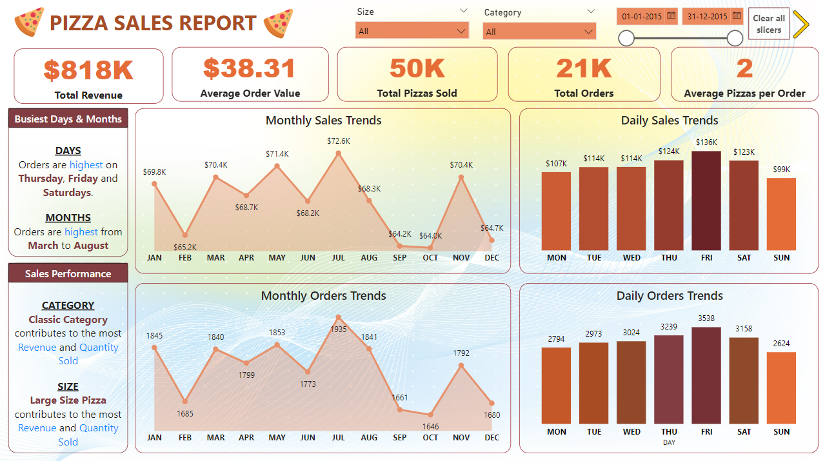
Performance Trends

Slide 3
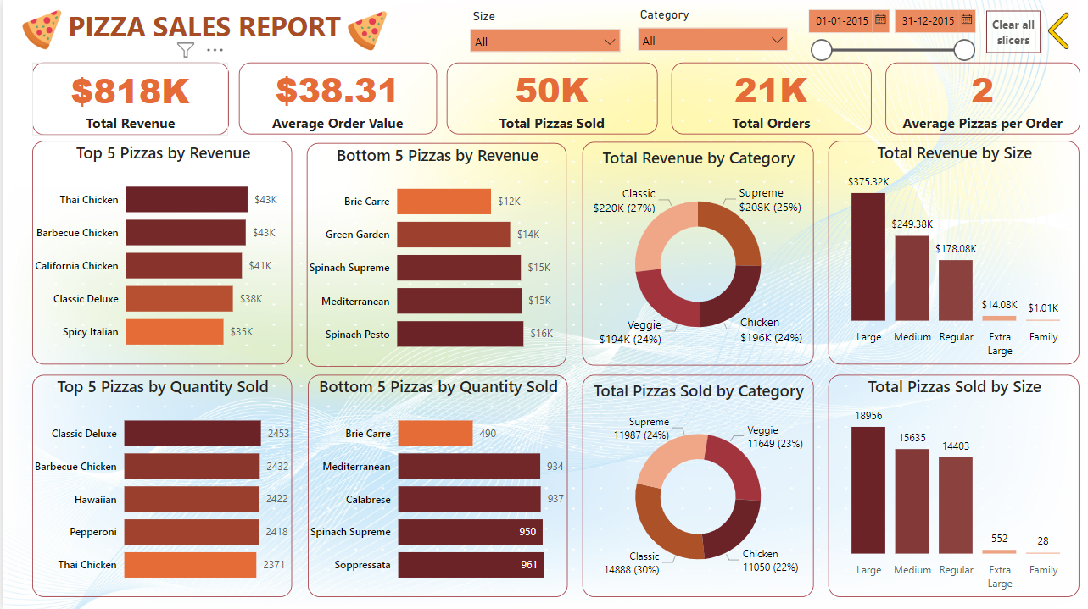
Categorical Insights

Slide 4

Insights
Orders are highest from March to August. It starts dipping after July till October.
The revenue of pizza sales follow a similar trend as the orders, peaking in July.
Orders are highest on Thursdays, Fridays and Saturdays and dips on Sunday
Classic Category contributes to the most Pizzas sold.
All the pizza categories contribute to the revenue almost evenly with the classic category topping them all.
Large size pizzas are the most sold while Extra Large and Family size are the least sold pizzas.
The Classic Deluxe Pizza is the most sold pizza while The Thai Chicken Pizza rakes in the most revenue.
The Barbeque Chicken Pizza, The Classic Deluxe Pizza and The Thai Chicken Pizza are the highest performing SKUs.
Brie Carre Pizza is the lowest selling pizza and also brings the least revenue.

